Slide 1

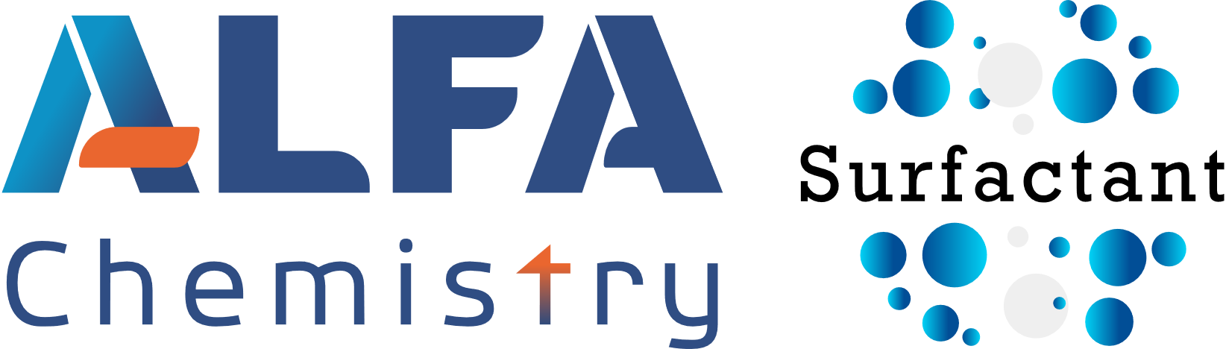
Lignin-based
Surfactants
Alfa Chemistry
An ISO9001:2015 certified Supplier of High-Quality Surfactants, Custom Synthesis and Provider of Testing Services.
Tel: 1-516-662-5404
Fax: 1-516-927-0118
Email: info@alfa-chemistry.com
https://surfactant.alfa-chemistry.com/

Slide 2



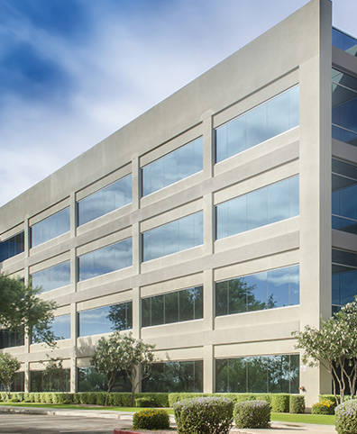
Alfa Chemistry
Alfa Chemistry is an ISO9001:2015 certified Supplier of High-Quality Surfactants, Custom Synthesis and Provider of Testing Services. We have served the following industries for years: Household chemicals, Food Industry, Oil field, Agriculture, Textile Industry, Pharmaceutical Industry, etc.
We supply all kinds of Amphoteric Surfactants, Anionic Surfactants, Cationic Surfactants, and Non-ionic Surfactants. If you would like to receive a copy of our product catalog, please contact us at info@alfa-chemistry.com.
Advanced technology and scientific management
Advanced production and testing equipment
Rich experiences
101-5 Colin Dr, Holbrook, NY 11741
Alfa Chemistry — An ISO9001:2015 certified Supplier
Tel: 1-516-662-5404
Fax: 1-516-927-0118
Email: info@alfa-chemistry.com
https://surfactant.alfa-chemistry.com/
101-5 Colin Dr, Holbrook, NY 11741

Slide 3
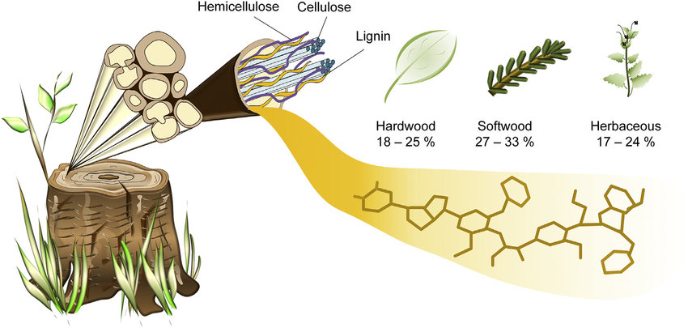
Lignin-based Surfactants
Lignin is ranked second after cellulose in availability as a natural polymer on earth and can be utilized to produce value-added products.
Fig. 1 Occurrence of lignin in nature*
Lignin has great potential for use as a surfactant given its hydrophobic aromatic configuration. Lignosulfonates produced as the by-products of the sulfite pulping processes are currently used as surfactants. Lignosulfonates possess a hydrophilic sulfonate group on their aliphatic head and a hydrophobic aromatic ring.
Properties:
Applications:
Low production costs
Good adsorption affinity
Good wettability
Good dispersibility
Natural source
…
As anionic surfactants in concrete admixtures
As corrosion inhibitors, emulsifiers and as ion-exchange resins in pesticides
As water reducer, asphalt emulsifier and oil displacement agent in collection process of crude oil.
…
* Judith Becker. A ﬁeld of dreams: Lignin valorization into chemicals, materials, fuels, and health-care products.
Alfa Chemistry — An ISO9001:2015 certified Supplier
Tel: 1-516-662-5404
Fax: 1-516-927-0118
Email: info@alfa-chemistry.com
https://surfactant.alfa-chemistry.com/
101-5 Colin Dr, Holbrook, NY 11741

Slide 4
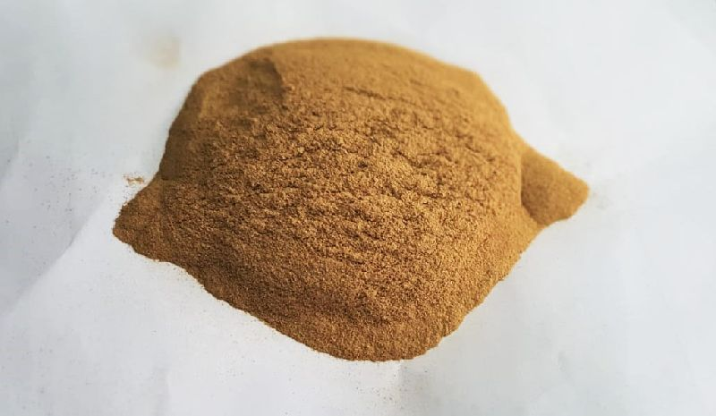
Sodium Lignosulfonate
Sodium lignosulfonate is a yellow brown powder which is extracted from the pulping liquid by the procedures of purification, evaporation, chemical treatment, and drying.
Typical Applications:
Product Name: | Sodium lignosulfonate
Catalog No.: | ACM8061516
CAS No.: | 8061-51-6
In Construction
As a plasticizer, water reducing agent
In Coal Slurry
As a dispersant
In Ceramics
As a body enhancer
To achieve low viscosity
In Dye Industry
As filler and dispersant
In Pesticides
As a suspending agent, dispersant,
and filler
Balling of materials
As a binder
In Petroleum products
As an emulsifying viscosity reducer, antistatic agent, anti rust agent, dispersant, and cleaning agent
Test | Specification
Appearance | Yellow brown powder
pH | 10-12
Dry matter | 92% min
Moisture | 10.0% max
Water insoluble matter | 1.5% max
Lignosulphonate | 50% min
Total reducing matter | 10.0% max
Alfa Chemistry — An ISO9001:2015 certified Supplier
Tel: 1-516-662-5404
Fax: 1-516-927-0118
Email: info@alfa-chemistry.com
https://surfactant.alfa-chemistry.com/
101-5 Colin Dr, Holbrook, NY 11741

Slide 5
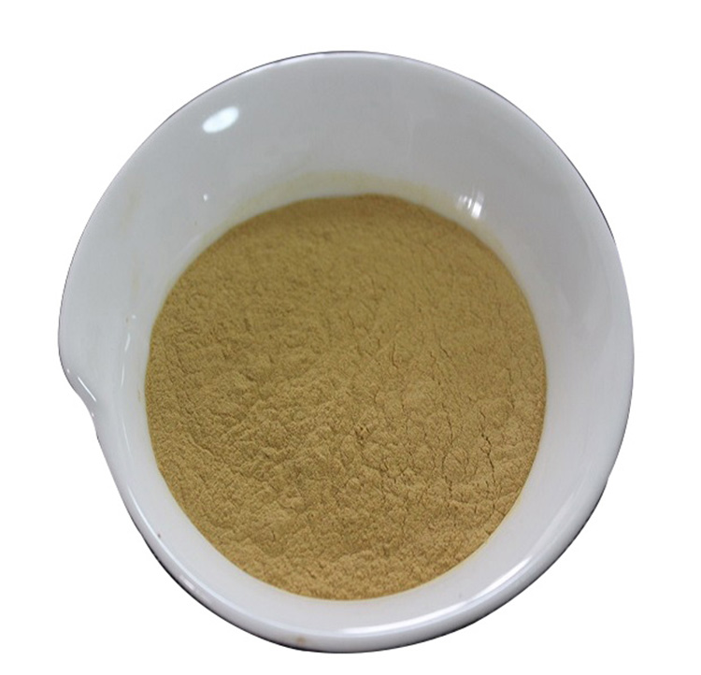
Calcium Lignosulfonate
Calcium lignosulfonate is a yellow brown powder which is produced from the sulfite pulping of softwood.
Typical Applications:
Product Name: | Calcium lignosulfonate
Catalog No.: | ACM8061527
CAS No.: | 8061-52-7
Dispersing agent in concrete and carbon black-rubber mixes
Extender for tanning agents
Oil-well drilling additives
Ore flotation agents
Production of vanillin
Industrial cleaners
Gypsum slurried
Dyestuffs
Pesticide formulations
Water reducing agent of concrete
Test | Specification
Appearance | Yellow brown powder
pH | 5-6
Inorganic salts (Na2SO4) | 5.0% max
Moisture | 5.0% max
Total reducing matter | 4.0% max
Water insoluble matter | 1.5% max
Calcium magnesium general quantity | 0.3-1.5%
Alfa Chemistry — An ISO9001:2015 certified Supplier
Tel: 1-516-662-5404
Fax: 1-516-927-0118
Email: info@alfa-chemistry.com
https://surfactant.alfa-chemistry.com/
101-5 Colin Dr, Holbrook, NY 11741

Slide 6

Custom Synthesis and
Product Development
Alfa Chemistry's founding idea is to deliver professional services to its customers. Through our large product line, Alfa Chemistry has developed strong synthesis knowledge. Custom synthesis needs are met by utilizing our extensive technical knowledge and experience, as well as the usage of a wide range of facilities and equipment.
Well-trained chemists and technicians
Rich expertise in the field of surfactants
Fully equipped laboratory
To learn more about our specialized services and how we can help you fulfill your business objectives, please contact Alfa Chemistry.
Alfa Chemistry — An ISO9001:2015 certified Supplier
Tel: 1-516-662-5404
Fax: 1-516-927-0118
Email: info@alfa-chemistry.com
https://surfactant.alfa-chemistry.com/
101-5 Colin Dr, Holbrook, NY 11741

Slide 7


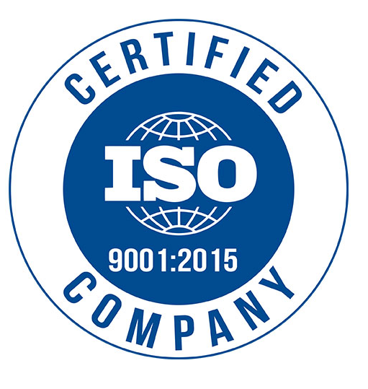
look forward to cooperating with you
Tel: 1-516-662-5404
Fax: 1-516-927-0118
Email: info@alfa-chemistry.com
101-5 Colin Dr, Holbrook, NY 11741
Please visit our website https://surfactant.alfa-chemistry.com/

